Slide 1
Making the Case for Tobacco Treatment for Behavioral Health Clients
Notes:
About Presentation:
After using this presentation, please complete this form: https://redcap.uits.iu.edu/surveys/?s=HTMHH4F4WW
Target audience for presentation: Mental health and addiction providers/clinicians, other health-related professionals
Intended use: To educate providers on the “why and how” to address tobacco use among their behavioral health population.
Slides may be removed for tailoring to audiences.
Indiana Summit Goals:
Reducing smoking prevalence among people who report heavy drinking : 39% to 25% by 2025
Reducing smoking prevalence among people who report >14 days poor mental health: 37.8% to 25% by 2025
Literature resources:
From an organizational/infrastructure perspective, https://www.ncbi.nlm.nih.gov/pubmed/29279028
CDC’s Promising Policies And Practices To Address Tobacco Use By Persons With Mental And Substance Use Disorders, https://www.cdc.gov/tobacco/disparities/promising-policies-and-practices/index.html (July 2018)
CDC's Vital Signs - Adult Smoking: Focusing on People with Mental Illness (February 2013) http://www.cdc.gov/vitalsigns/pdf/2013-02-vitalsigns.pdf

Slide 2
U.S. Annual Adult Deaths from Smoking
More than
480,000
U.S. Deaths
Every Year
are from
Tobacco Use
Nearly 50% of annual deaths occur
among consumers with behavioral health conditions!
Note: Average annual number of deaths for adults aged 35 or older, 2005-2009.
U.S. Department of Health and Human Services. The Health Consequences of Smoking: 50 Years of Progress. A Report of the Surgeon General. Atlanta, GA: U.S. Department of Health and Human Services, Centers for Disease Control and Prevention, National Center for Chronic Disease Prevention and Health Promotion, Office on Smoking and Health, 2014.
Notes:
About slide:
Tobacco use is still the LEADING cause of preventable disease, disability, and death in the United States, causing more than 480,000 deaths each year. This is nearly one in five deaths
*animation*Nearly 50% of these annual deaths from smoking occur among consumers with behavioral health conditions (mental health condition and substance use disorder).
Smoking harms nearly every organ of the body, causes many diseases, and reduces the health of smokers in general.
However, the majority of people who use tobacco want to quit, most try to quit multiple times (on average 30x) before succeeding.
Tobacco dependence is a chronic, relapsing disorder that, like other chronic diseases, often requires repeated intervention and long-term support. As healthcare providers, we need to ensure we are offering patients evidence-based treatment to set our patients up for success!
Note: Average annual number of deaths for adults aged 35 or older, 2005-2009.
Source: 2014 Surgeon General's Report. Table 12.4. page 660.

Slide 3
Current Smoking Trends
Source: 2020 Indiana Behavioral Risk Factor Surveillance System
Notes:
Indiana Trends:
Statistically significant decline from 2011-2019 (increase from 2019-2020 is not significant)
According to the 2020 Census the Indiana population (18+) is 5,192,579 people. Of those 19.4% are current smokers or approximately 1,007,360 Hoosiers.

Slide 4
Current Smoking:
2020 Demographics
Note: Race and ethnicity are treated as mutually exclusive categories.
Notes:
About Slide:
The BLACK line you see across the chart is the overall smoking rate for Indiana (19.4%).
Rate of smoking significantly lower among Hispanics compared to both African American and white adults.
Those between ages 25-64 had significantly higher rates of smoking compared to those that are18-24 (young adults) or those 65 and up.
Overall: 1,007,360
Males: 20.8% = 1,080,056
Females: 18.1% = 939,857
African Americans: 20.4% = 1,059,286
White: 19.9% = 1,033,324
Hispanic: 11.1% = 576,377
18-24: 11.4% = 591,955
25-34: 23.6% = 1,225,449
35-44: 25.3% = 1,313,723
45-54: 22.2% = 1,152,753
55-64: 25.3% = 1,313,723
65+: 10.1% = 524,451

Slide 5
Current Smoking:
2020 Demographics
Notes:
About slide:
Those with less than a high school education, had significantly higher rate of smoking than any other level of education attained. Those that had a college education had a significantly lower rate of smoking than any other level of education attained. In general, the rate of smoking decreased as the reported income level increased.
I want to highlight that what we are seeing here is because of direct targeting by the tobacco industry. We know that that the tobacco industry advertises, discounts and displays commercial tobacco products in some communities more than others. These tailored tactics push dangerous tobacco products into the communities that have the fewest resources to deal with the health problems that come with them.

Slide 6
Current Smoking:
2020 Marginalized Populations
Notes:
About Slide:
This slide provides examples of how tobacco disproportionately impacts groups facing disadvantage. These populations continue to see increased rates of smoking.
Those experiencing 14 or more poor mental health days reported smoking at a significantly higher rate than those experiencing fewer than 14 poor mental health days.
Those ever diagnosed with depression (depressive disorder) reported smoking at a significantly higher rate than those never diagnosed with Depression.
We didn’t see a significant difference in smoking rates among those that are LGBT and those that are straight, not transgender but note that there is increased rate of use for those that identify as LGBT compared to the overall population.
Those without insurance reported smoking at significantly higher rates than those with insurance.
There were not any significant differences in smoking rates among women of child-bearing age and those 45 and older.

Slide 7
Smoking and Behavioral Health:
The Heavy Burden
Overall, adults with a Behavioral Health (BH) condition are more likely to smoke (28% versus 14%)
Most common causes of death among those with a BH condition include cancer, heart disease, and lung disease – all of which can be caused by smoking.
Among Adults with Any Mental Illness (AMI)
  Adults with AMI are more likely to smoke (27% compared to 16%)
  Smoke more cigarettes (2 packs more per month)
  Smoking can impact the efficacy of prescribed therapies
Among Adults with Substance Use Disorder (SUD)
  Adults with a SUD are more likely to smoke (42% compared to 16%)
  Face challenges when trying to quit- less than half of substance abuse facilities offer tobacco cessation counseling
  Smoking can increase the likelihood of substance abuse relapse
Sources available upon request
Notes:
About Slide:
Overall, adults with a behavioral health condition smoke at twice the rate of adults without a behavioral health condition. (28% versus 14%)
Most common causes of death among those with a BH condition include: cancer, heart disease, and lung disease – all of which can be caused by smoking.
When looking at adults with any mental illness (or AMI), we see:
Increased smoking rates (27% compared to 16%)
Increased number of cigarettes smoked (2 packs more per month)
Smoking making an impact on course of treatment - specifically nicotine may reduce the efficacy of prescribed therapies, requiring increased doses of medication compared to non-smokers.
When looking at adults with substance use disorders (SUD) we see:
Increased smoking rates (42% compared to 16%)
Challenges related to quitting, as less than half of all substance abuse facilities offer tobacco cessation counseling
Increased likelihood of substance abuse relapse among smokers compared to non-smokers (those in a substance abuse facility)
Sources:
Lipari, R.N. and Van Horn, S.L. Smoking and mental illness among adults in the United States. The CBHSQ Report: March 30, 2017. Center for Behavioral Health Statistics and Quality, Substance Abuse and Mental Health Services Administration, Rockville, MD.
Smoking Cessation Leadership Center. Fact Sheet: Drug Interactions With Tobacco Smoke. San Francisco: Smoking Cessation Leadership Center, University of California, 2015 [accessed 2020 Dec 15]
Tipperman, Doug. (2020). Smoking and Behavioral Health:2019 NSDUH Trend Data Update. U.S. Department of Health and Human Services. Substance Abuse and Mental Health Services Administration. https://smokingcessationleadership.ucsf.edu/sites/smokingcessationleadership.ucsf.edu/files/Documents/FactSheets/NSDUH%20Smoking% 20BH%20Trend%20Data %20-%202019%20Update.pdf

Slide 8
Why are Smoking Rates Higher Among Behavioral Health Consumers?
For years, the tobacco industry has used multiple strategies to market cigarettes to vulnerable populations, including those with behavioral health conditions. These strategies include:
  Financial contributions to orgs that work with persons with mental health disorders.
  Funding research to foster the myth that cessation would be too stressful because persons with mental health disorders use nicotine to alleviate negative mood (i.e., self-medicate).
  Providing free or reduced-cost cigarettes to psychiatric facilities.
  Supporting efforts to block smoke/tobacco-free psychiatric hospital policies.
  Creating marketing plans that target marginalized populations, including persons with mental health disorders. One example was “Project SCUM” which was implemented in San Francisco in the mid-1990s.
See for yourself, visit: www.industrydocuments.ucsf.edu/tobacco/
Notes:
About slide:
Explanation of why Behavioral health consumers have higher tobacco use rates
For years, the tobacco industry has used multiple strategies to market cigarettes to vulnerable populations, including those with behavioral health conditions. These strategies include:
Developing relationships with and making financial contributions to organizations that work with persons with mental health disorders.
Funding research to foster the myth that cessation would be too stressful because persons with mental health disorders use nicotine to alleviate negative mood (i.e., self-medicate).
Providing free or reduced-cost cigarettes to psychiatric facilities.
Supporting efforts to block smoke-free psychiatric hospital policies.
Creating marketing plans that target marginalized populations, including persons with mental health disorders. One example was “Project SCUM” (Sub Culture Urban Marketing), which was implemented in San Francisco in the mid-1990s.
Truth Tobacco Industry Documents – An archive of 14 million documents created by tobacco companies about their advertising, manufacturing, marketing, scientific research, and political activities, hosted by UCSF library. Link: : www.industrydocuments.ucsf.edu/tobacco/
Sources:
MARKETING TO THE MARGINALIZED: TOBACCO INDUSTRY TARGETING OF THE HOMELESS AND MENTALLY ILL: https://escholarship.org/uc/item/73d0x34w#page-7
www.industrydocuments.ucsf.edu/tobacco/
https://www.ncbi.nlm.nih.gov/pmc/articles/PMC2632440/

Slide 9
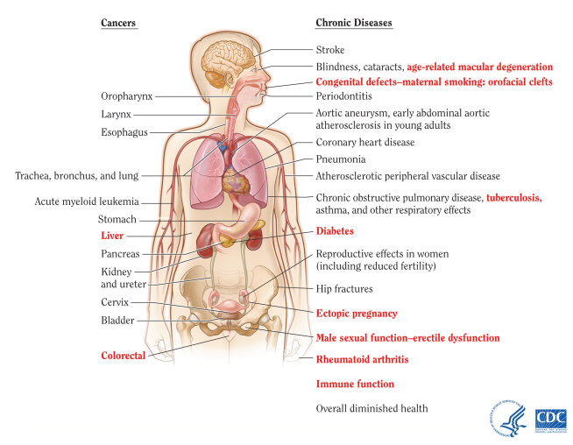
Health Consequences of Smoking
U.S. Department of Health and Human Services. The Health Consequences of Smoking: 50 Years of Progress. A Report of the Surgeon General. Atlanta, GA: U.S. Department of Health and Human Services, Centers for Disease Control and Prevention, National Center for Chronic Disease Prevention and Health Promotion, Office on Smoking and Health, 2014.
Notes:
About slide:
Smoking can damage nearly every part of your body.
Visual depiction of the various cancers and chronic diseases caused from smoking.
Each condition presented in bold red text and followed by an asterisk (*) is a new disease causally linked to smoking in the 2014 Surgeon General’s Report, The Health Consequences of Smoking—50 Years of Progress.
Cancers
Oropharynx
Larynx
Esophagus
Trachea, bronchus, and lung
Acute myeloid leukemia
Stomach
Liver
Pancreas
Kidney and ureter
Cervix
Bladder
Colorectal
Chronic Diseases
Stroke
Blindness, cataracts, age-related macular degeneration*
Congenital defects-maternal smoking: orofacial clefts*
Periodontitis
Aortic aneurysm, early abdominal aortic atherosclerosis in young adults
Coronary heart disease
Pneumonia
Atherosclerotic peripheral vascular disease
Chronic obstructive pulmonary disease, tuberculosis,* asthma, and other respiratory effects
Diabetes*
Reproductive effects in women (including reduced fertility)
Hip fractures
Ectopic pregnancy*
Male sexual function-erectile dysfunction*
Rheumatoid arthritis*
Immune function*
Overall diminished health
Source: U.S. Department of Health and Human Services. The Health Consequences of Smoking: 50 Years of Progress. A Report of the Surgeon General. Atlanta, GA: U.S. Department of Health and Human Services, Centers for Disease Control and Prevention, National Center for Chronic Disease Prevention and Health Promotion, Office on Smoking and Health, 2014.

Slide 10
Birth and Infant Outcomes
Infant/Child Harm from Tobacco Use
Maternal/Fetal Harm from Tobacco Use
  Infertility
  Miscarriage
  Ectopic Pregnancy
  Premature Birth
  Low Birth Weight
  Stillbirth
  SIDS
  SIDS
  Ear infections
  Respiratory Infections
  Asthma
  Links with childhood obesity, cancer, attention disorders
Tobacco use during pregnancy is directly associated
with the top four causes of infant mortality
Notes:
About slide:
It has long been known that smoking is harmful to reproductive health!
Research has found that women who smoke are more likely to deliver their babies early (premature or preterm birth) and to deliver low birth weight babies, even if born full term. Both preterm delivery and low birth weight are associated with increased risk for infant death
Rates of preterm birth/low-birth weight, respiratory distress syndrome and SIDS could all improve dramatically if pregnant women and their partners did not smoke during and after pregnancy, and if infants were always in smoke-free environments, especially in their homes, child care locations, public places and automobiles.
Rosenberg DC and Buescher PA. The association of maternal smoking with infant mortality and low birth weight in North Carolina, 1999. State Center for Health Statistics 2002; Special
Report No. 135.

Slide 11



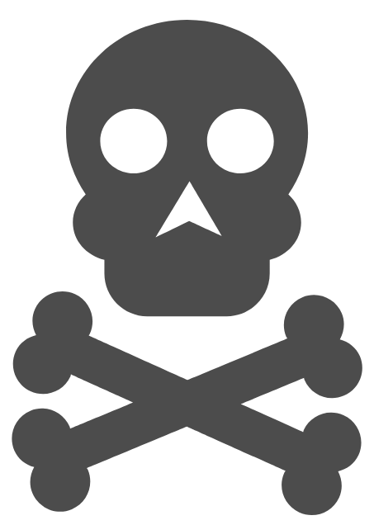

Adverse Health Effects of Tobacco Use on Persons with Behavioral Health Conditions
Nicotine has mood-altering effects that can temporarily mask the negative symptoms of mental illness, putting people w/ mental illness at higher risk for cigarette use & nicotine addiction.
Tobacco smoke can interact with and inhibit the effectiveness of certain medications taken by mental health and substance abuse patients.
People with mental illness or substance use disorders die up to 10-25 years earlier than those w/o these disorders; many of these deaths are caused by smoking cigarettes.
Persons with SUD who smoke cigarettes are four times more likely to die prematurely than those who do not smoke.
The most common causes of death among people with mental illness are heart disease, cancer, and lung disease, which can all be caused by smoking.
CDC. Vital Signs: Current Cigarette Smoking Among Adults Aged ≥18 Years With Mental Illness—United States, 2009–2011. MMWR 2013;62(05):81-87; Druss BG, Zhao L, Von Esenwein S, Morrato EH, Marcus SC. Understanding Excess Mortality in Persons With Mental Illness: 17-Year Follow Up of a Nationally Representative US Survey. Medical Care 2011;49(6):599–604; CDC. Vital Signs Fact Sheet: Adult Smoking Focusing on People With Mental Illness, February 2013. NCCDPHP, Office on Smoking and Health, 2013 SCLC. Fact Sheet: The Tobacco Epidemic Among People With Behavioral Health Disorders. San Francisco: SCLC, University of California, 2015; Smoking Cessation Leadership Center. Fact Sheet: Drug Interactions With Tobacco Smoke. San Francisco: SCLC, University of California, 2015.
Notes:
About slide:
Nicotine has mood-altering effects that can temporarily mask the negative symptoms of mental illness, putting people w/ mental illness at higher risk for cigarette use & nicotine addiction. Daily tobacco use is associated with increased risk of psychosis and an earlier age at onset of psychotic illness (Gurillo P, et al., 2015).Heavy smoking is a signiﬁcant risk factor for major depression.
Tobacco smoke can interact with and inhibit the effectiveness of certain medications taken by mental health and substance abuse patients. Smoking accelerates the metabolism of certain psychiatric medications resulting in the need for higher doses. (This is not true of smokeless products)
Persons with substance use disorder (SUD) who smoke cigarettes are four times more likely to die prematurely than those who do not smoke. Smoking is a strong predictor of risk for nonmedical use of prescription opioids. Additionally, people who continue smoking following treatment for a substance use disorder have significantly greater odds of relapse.
Persons with mental illness, on average, die several years earlier than persons without mental illness – with smoking being a major contributing factor.
The most common causes of death among people with mental illness are heart disease, cancer, and lung disease, which can all be caused by smoking.
Smoking tobacco causes more deaths among people who had been in substance abuse treatment than the alcohol or drug use that brought them to treatment.
Tobacco use is associated with increased suicidal ideations, suicide attempts, and completed suicides.
More than 50% of patients with terminal cancer have at least one psychiatric disorder and those with MI 2.6x more likely to develop cancer due to late stage diagnosis/inadequate treatment and screenings
Other consequences:
Creates financial hardship
Interferes with employment opportunities
Makes it difficult to secure housing
Sources: CDC. Vital Signs: Current Cigarette Smoking Among Adults Aged ≥18 Years With Mental Illness—United States, 2009–2011. MMWR 2013;62(05):81-87; Druss BG, Zhao L, Von Esenwein S, Morrato EH, Marcus SC. Understanding Excess Mortality in Persons With Mental Illness: 17-Year Follow Up of a Nationally Representative US Survey. Medical Care 2011;49(6):599–604; CDC. Vital Signs Fact Sheet: Adult Smoking Focusing on People With Mental Illness, February 2013. NCCDPHP, Office on Smoking and Health, 2013 SCLC. Fact Sheet: The Tobacco Epidemic Among People With Behavioral Health Disorders. San Francisco: SCLC, University of California, 2015; Smoking Cessation Leadership Center. Fact Sheet: Drug Interactions With Tobacco Smoke. San Francisco: SCLC, University of California, 2015.

Slide 12

WHAT WE KNOW
Smoking exacerbates symptoms of behavioral health conditions:
    Greater depressive symptoms
    Greater likelihood of psychiatric hospitalization
    Increased suicidal behavior
    Drug and alcohol-use relapse
Tobacco cessation can have mental health benefits
Tobacco dependence treatment, during addictions treatment, is associated with a 25% increased likelihood of long-term abstinence from alcohol and illicit drugs.
Compton W. The need to incorporate smoking cessation into behavioral health treatment. The American Journal on Addictions.2018;27(1):42–43
Prochaska JJ, Das S, Young-Wolff KC. Smoking, Mental Illness, and Public Health. Annu Rev Public Health. 2017;38:165–185.doi: 10.1146/annurev-publhealth-031816-044618.
Weinberger AH, Platt J, Esan H, Galea S, Erlich D, Goodwin RD. Cigarette smoking is associated with increased risk of substance usedisorder relapse: a nationally representative, prospective longitudinal investigation. The Journal of Clinical Psychiatry. 2017;2(78):e152.
Notes:
About slide:
Smoking exacerbates symptoms of behavioral health conditions.
Smoking is associated with worse symptoms and outcomes among people with behavioral health conditions, including greater depressive symptoms, greater likelihood of psychiatric hospitalization, increased suicidal behavior, and drug- and alcohol-use relapse.
Quitting smoking is associated with an increase in long-term abstinence from alcohol and other drugs and a reduction in substance use disorder relapse.
*Animation* Tobacco dependence treatment, during addictions treatment, is associated with a 25% increased likelihood of long-term abstinence from alcohol and illicit drugs. (Prochaska)
Sources:
Compton W. The need to incorporate smoking cessation into behavioral health treatment. The American Journal on Addictions.2018;27(1):42–43
Prochaska JJ, Das S, Young-Wolff KC. Smoking, Mental Illness, and Public Health. Annu Rev Public Health. 2017;38:165–185.doi: 10.1146/annurev-publhealth-031816-044618.
Weinberger AH, Platt J, Esan H, Galea S, Erlich D, Goodwin RD. Cigarette smoking is associated with increased risk of substance usedisorder relapse: a nationally representative, prospective longitudinal investigation. The Journal of Clinical Psychiatry. 2017;2(78):e152.

Slide 13
What are we doing in Indiana to combat the tobacco epidemic?
Examining Statewide Strategies
Notes:
Transition slide – will examine the Indiana Tobacco-Free Recovery (AKA Summit)

Slide 14
Introduction to Indiana Leadership Academy for Wellness & Tobacco-Free Recovery
June 2019: Statewide collaboration among the Indiana Department of Health and the Indiana Family and Social Services Administration to host a summit in Indianapolis to address the high prevalence of smoking among adults in Indiana with behavioral health conditions.
Outcome: Indiana Action Plan for Tobacco-Free Recovery
  Reduce prevalence of current cigarette smoking among Indiana Adults Aged 18 Years and Older by Mental Health* Status to 25% by 2025
  Reduce prevalence of current cigarette smoking among Indiana Adults Aged 18 Years and Older by Heavy Drinking** Status to 25% by 2025
*Poor Mental Health: defined as 14 or More of the Past 30 Days Not Good.
**Heavy drinking: 2015-2017 defined as consuming on average more than 14 drinks per week for men, more than 7 drinks per week for women; 2011 to 2014 defined as consuming on average more than 2 drinks per day for men and one drink per day for women.
Notes:
About Slide:
In June 2019, the Indiana State Department of Health (ISDH) and the Indiana Family and Social Services Administration (FSSA), invited leaders and advocates in public health, behavioral healthcare, government agencies, Medicaid managed care entities, and tobacco control to host the Indiana Leadership Academy for Wellness and Tobacco Free Recovery Summit to address the high prevalence of smoking among adults in Indiana with mental illness or substance use disorder (behavioral health conditions). The Summit was held in partnership with the following organizations:
Substance Abuse and Mental Health Services Administration (SAMHSA),
CDC’s National Behavioral Health Network (NBHN), and
Smoking Cessation Leadership Center (SCLC)/University of California, San Francisco (UCSF)
The purpose of the state summit: was to assemble a carefully selected group of leaders and stakeholders in Indiana to work together and find applicable solutions in reducing tobacco use among individuals with behavioral health conditions. The day and a half format began with attendees viewing a comprehensive Indiana Gallery Walk that displayed national, state, and county level data on tobacco related use, policy, and quality of care for this priority population.
Stakeholders developed an action plan as a product of the summit, including practical strategies (education, data, policy and advocacy, communications) that aim to significantly increase smoking cessation and quit attempts, increase tobacco use prevention, and ultimately reduce the tobacco use prevalence among the behavioral health population.
The 2017smoking prevalence among adults who reported poor mental health is 37.8%. *Poor Mental Health: defined as 14 or More of the Past 30 Days Not Good.
The target is to lower the prevalence to 25% by 2025.
The 2017 smoking prevalence among adult heavy drinkers is 39.1%. The target is to lower the prevalence to 25% by 2025. **Heavy drinking: 2015-2017 defined as consuming on average more than 14 drinks per week for men, more than 7 drinks per week for women; 2011 to 2014 defined as consuming on average more than 2 drinks per day for men and one drink per day for women.

Slide 15
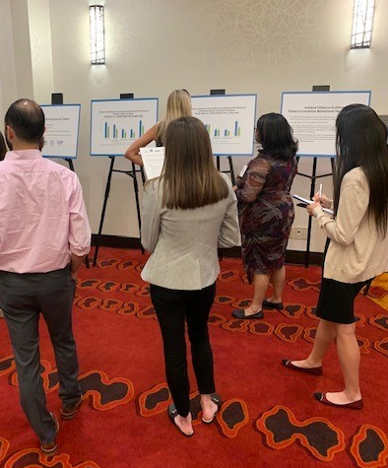
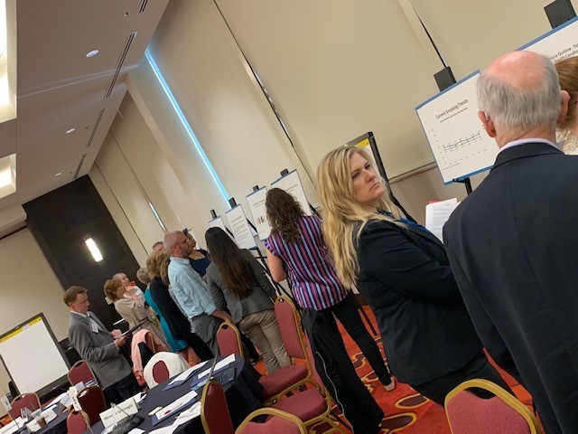

Initial Statewide Tobacco-Free Recovery Summit
June 2019
Notes:
Photos of initial 2-day summit in June 2019.
The day and a half format began with attendees viewing a comprehensive Indiana Gallery Walk that displayed national, state, and county level data on tobacco related use, policy, and quality of care for this priority population
Tables came up with their ideas of achievable goals and worked to create an action plan and practical strategies to achieve goals.

Slide 16
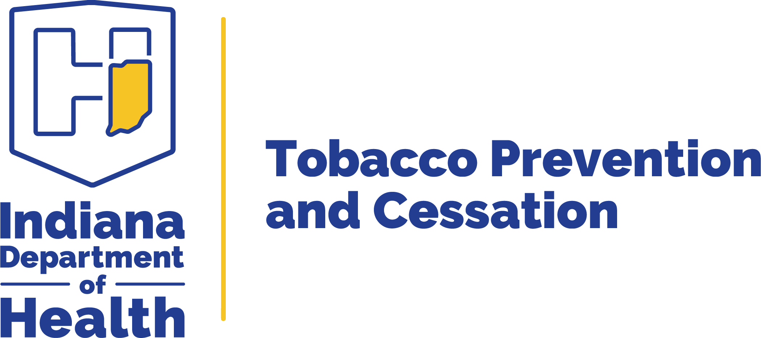





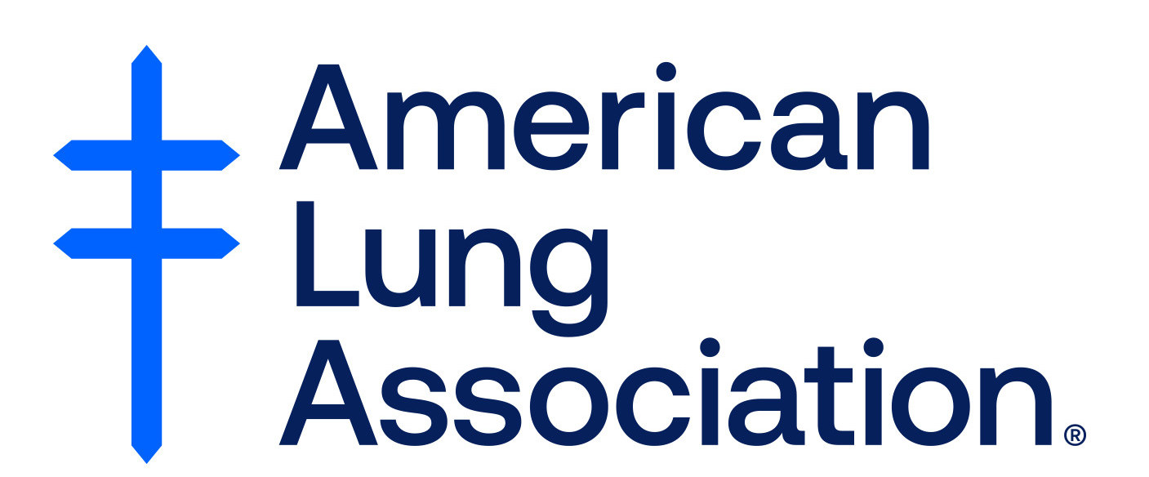









Statewide Collaboration
Notes:
Statewide Collaboration among many Indiana organizations.
Summit held in partnership with the following organizations:
Substance Abuse and Mental Health Services Administration (SAMHSA),
CDC’s National Behavioral Health Network (NBHN), and
Smoking Cessation Leadership Center (SCLC)/University of California, San Francisco (UCSF)
Those in attendance included industry leaders and stakeholders representing tobacco control, behavioral health, public health, cancer control, managed care, advocacy and consumer groups, criminal justice, universities, and other services from across the state.

Slide 17
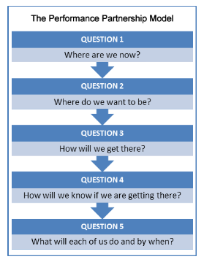
Support from National Networks: Academy States on Tobacco Control in Behavioral Health
MT
MN
MA
MI
NY
PA
NJ
IN
MD
KS
KY
NC
OK
AR
SC
AZ
MS
TX
HI
Alaska
Hawaii
Notes:
About Slide: History of Academy states and the work the SCLC has done.
Beginning in 2009, partnering with the Smoking Cessation Leadership Center (SCLC), SAMHSA launched the “100 Pioneers for Smoking Cessation Campaign”.
The Campaign provided support to behavioral health facilities and organizations to address tobacco use among people with mental and substance use disorders (Santhosh et al., 2014).
To create broader reach, in 2010, SAMHSA and SCLC began to convene Leadership Academies for Wellness and Smoking Cessation summits.
The summits were held with the goal of mobilizing policymakers and stakeholders (including leaders in tobacco control, mental health, SUD prevention and treatment, Medicaid, and public health, as well as behavioral health services consumers) to develop and implement collaborative state-specific action plans to reduce smoking rates among behavioral health services consumers and staff.
Performance Partnership Model: We used this model to form the Indiana goals
Where are we now? (Baseline) ► Where do we want to be? (Target) ► How do we get there? (Multiple Strategies) ► How do we know we are getting there? (Evaluation)

Slide 18
Academy State Success Stories
New York
  21 out of 23 NYS Office of Mental Health state operated campuses have tobacco free policy
Maryland
  Smoking prevalence for addiction treatment consumers dropped from 71.8% in 2010 to 56.5% in 2014.
Oklahoma
  Smoking prevalence for addiction treatment consumers served by the ODMHSAS provider system dropped from 74% in 2009 to 47% in 2014 (self-report data).
Texas
  Trained 4,600 behavioral health treatment providers in tobacco cessation. All local mental health authorities tobacco-free by end of 2015.
North Carolina
  All state behavioral healthcare facilities have adopted a tobacco-free campus policy. Reconvened in September 2018
Notes:
About slide:
Other academy states and their accomplishments

Slide 19
Current Smoking Prevalence among Indiana Adults Aged 18 Years and Older by
Mental Health Status*
*Poor Mental Health defined as 14 or More of the Past 30 Days Not Good.
Question Wording: Now thinking about your mental health, which includes stress, depression, and problems with emotions, for how many days during the past 30 days was your mental health not good?
Source: 2011-2020 Indiana Behavioral Risk Factor Surveillance System
Notes:
Indiana Trends:
Reminder that ‘25 by 2025’ targets were set based on 2017 BRFSS data
We added a trend line that corresponds to the targets set in the 2025 Indiana Tobacco Control Strategic Plan around this sub-population, in addition to the 25 by 2025 goal set by participants of the recovery summit.
No statistically significant change from 2017-18 among smokers with 14 or more poor mental health days. There was a significant decrease in smoking among those with 14 or more poor mental health days (P-value 0.031), from 2018 to 2019. No significant change between 2019-2020.

Slide 20
Indiana: Current Smoking Prevalence among Adults aged 18 Years and Older by
Heavy Drinking Criteria*
* Heavy drinking: 2015-2020 defined as consuming on average more than 14 drinks per week for men, more than 7 drinks per week for women; 2011 to 2014 defined as consuming on average more than 2 drinks per day for men and one drink per day for women.
Source: 2011-2020 Indiana Behavioral Risk Factor Surveillance System
Notes:
Indiana Trends:
Reminder that ‘25 by 2025’ targets were set based on 2017 BRFSS data
The smoking prevalence is much higher among those individuals that met the heavy drinking definition.
No significant change in smoking prevalence among those who met the heavy drinking criteria between 2019-2020, however the rate has significantly decreased over time (since 2011).
Definition of Heavy drinking: 2015-2020 defined as consuming on average more than 14 drinks per week for men, more than 7 drinks per week for women; 2011 to 2014 defined as consuming on average more than 2 drinks per day for men and one drink per day for women.

Slide 21
Tobacco Interventions in Indiana Behavioral Health and Substance Abuse Treatment Facilities, 2021
Intervention | Mental Health Treatment Facilities | Substance Abuse Treatment Facilities
Tobacco Use Screening | 89.6% | 82.0%
Cessation Counseling | 69.9% | 65.8%
Nicotine Replacement Therapy | 56.3% | 41.5%
Non-nicotine Cessation Medications | 55.2% | 43.2%
Smokefree Building/Grounds | 86.7% | 53.6%
Data from the National Directory of Substance Abuse Treatment Facilities; based on responses to SAMHSA’s National Substance Abuse Services Survey (IN data collected 12/09/2021; US data collected 11/19/2021).
Notes:
About Slide:
Table: Percentage of U.S. mental health and substance abuse treatment facilities that offer tobacco screening and cessation treatment, NRT, non-nicotine medications, and that prohibit smoking in all indoor and outdoor settings, by type of facility
None are at 100%! Opportunities exist to enhance both smoke-free environments and tobacco cessation treatment in mental health and substance abuse treatment settings in Indiana. Given that tobacco cessation in behavioral health treatment could improve both physical and behavioral health outcomes, and continued smoking worsens those outcomes, behavioral health treatment facilities are an important setting for evidence-based tobacco cessation interventions
Limitations: data are self-reported by facility personnel and might be subject to bias. Second, data are at the facility level rather than patient level and facilities are counted equally regardless of size, precluding estimates of individual patients’ access to cessation interventions.
Source:
Data from the National Directory of Substance Abuse Treatment Facilities; based on responses to SAMHSA’s National Substance Abuse Services Survey (IN data collected 12/09/2021; US data collected 11/19/2021).

Slide 22
Myths About Smoking and Behavioral Health Consumers
“Tobacco is necessary self-medication”
  Fact: industry has supported this myth
“They are not interested in quitting”
  Fact: same % wish to quit as general population
“They can’t quit”
  Fact: quit rates same or slightly lower than general population
“Quitting worsens recovery from the mental illness”
  Fact: not so; and quitting increases sobriety for alcoholics
“It is a low priority problem”
  Fact: Tobacco-related diseases are the biggest killer for those with mental illness or substance use disorder.
Source: Prochaska, NEJM, July 21, 2011
Notes:
Tobacco is necessary self-medication
Fact: The tobacco industry has fostered this belief by funding research and presentations on the self-medication hypothesis, supporting opposition to the JCAHO smoking ban, publishing articles in the lay press, and marketing cigarettes to people with mental illness
They are not interested in quitting
Fact: Research argues otherwise: studies involving patients recruited from outpatient and inpatient psychiatric settings suggest that they are about as likely as the general population to want to quit smoking.1 In the United States, 20 to 25% of smokers report that they intend to quit smoking in the next 30 days, and another 40% say they intend to do so in the next 6 months. Furthermore, among smokers with mental illness, readiness to quit appears to be unrelated to the psychiatric diagnosis, the severity of symptoms, or the coexistence of substance use
They can’t quit
Fact: Although treating tobacco dependence is challenging, several randomized treatment trials and systematic reviews involving smokers with mental illness have documented that success is possible.
Quitting worsens recovery from the mental illness
Fact: not so; and quitting increases sobriety for alcoholics. Smoking cessation did not exacerbate depression or PTSD symptoms or lead to psychiatric hospitalization or increased use of alcohol or illicit drugs
It is a low priority problem
Fact people with psychiatric disorders are far more likely to die from tobacco-related diseases than from mental illness. Smokers know tobacco use has deadly consequences and expect health care professionals to intervene. Indeed, raising the issue of tobacco use with patients enhances the rapport between patients and clinicians
Source: Prochaska, NEJM, July 21, 2011
Reasons for BH providers to address tobacco use
Treating tobacco dependence saves lives and improves quality of life
Treating tobacco-dependence is cost- effective and saves healthcare dollars.
Treating tobacco dependence improves employee productivity and health.
Smoking disproportionately affects people with behavioral health problems.
Tobacco Use Disorder is a DSM-V Substance Use Disorder
Tobacco dependence and mental illness are SAMHSA-defined co-occurring disorders.
Behavioral health practitioners have more time than primary care providers for psychosocial treatments for tobacco dependence
Tobacco use interferes with psychiatric medications.

Slide 23
Helping CLIENTS TO
QUIT TOBACCO
Evidence-based tobacco treatment interventions

Slide 24
Why Should Behavioral Health Clinicians Address Tobacco?
Tobacco users expect to be encouraged to quit by health professionals. Screening for tobacco use and providing tobacco cessation counseling are positively associated with patient satisfaction.
Often the clinician for whom contact is the most frequent and who knows the patient best.
Trained in substance abuse treatment. Tobacco Use Disorder is a DSM-V Substance Use Disorder.
Trained in motivational interviewing.
Able to combine psychopharmacological and behavioral counseling treatment.
Failure to address tobacco use tacitly implies that
quitting is not important.
Barzilai et al. (2001). Prev Med 33:595–599; Conroy et al. (2005). Nicotine Tob Res 7 Suppl 1:S29–S34.
Notes:
About slide:
Tobacco users expect to be encouraged to quit by health professionals. In a study examining whether health habit counseling affects patient satisfaction, Barzilai et al. (2001) determined that of 12 health habits examined (exercise, diet, alcohol history, alcohol counseling, tobacco history, tobacco counseling, passive tobacco exposure, contraception and condom use, substance use history, substance use counseling, STD prevention, and counseling about HIV testing or prevention), only tobacco history and tobacco counseling were significantly associated with full satisfaction with the clinician visit. A clinician who does not address tobacco use during a clinical encounter tacitly implies that quitting is not important.
Often the clinician for whom contact is the most frequent and who knows the patient best.
Trained in substance abuse treatment. Tobacco Use Disorder is a DSM-V Substance Use Disorder.
Trained in motivational interviewing. MI is a great strategy for working with clients who are ambivalent about quitting.
Able to combine psychopharmacological and behavioral counseling treatment.
Suggested literature review: Snuffing out tobacco dependence. Ten reasons behavioral health providers need to be involved, by Jill Williams, MD, and Douglas M. Ziedonis, MD, MPH -http://www.behavioral.net/article/snuffing-out-tobacco-dependence
Reasons for BH providers to address tobacco use
Treating tobacco dependence saves lives and improves quality of life
Treating tobacco-dependence is cost- effective and saves healthcare dollars.
Treating tobacco dependence improves employee productivity and health.
Smoking disproportionately affects people with behavioral health problems.
Tobacco Use Disorder is a DSM-V Substance Use Disorder
Tobacco dependence and mental illness are SAMHSA-defined co-occurring disorders.
Behavioral health practitioners have more time than primary care providers for psychosocial treatments for tobacco dependence
Tobacco use interferes with psychiatric medications.
Barzilai DA, Goodwin MA, Zyzanski SJ, Stange KC. (2001). Does health habit counseling affect patient satisfaction? Prev Med 33:595–599.
Conroy MB, Majchrzak NE, Regan S, Silverman CB, Schneider LI, Rigotti NA. (2005). The association between patient-reported receipt of tobacco intervention at a primary care visit and smokers’ satisfaction with their health care. Nicotine Tob Res 7 Suppl 1:S29–S34.

Slide 25
Tobacco Recovery Benefits
Time Since Quit Date
Heart rate and blood pressure drop
20 mins
Circulation improves,
walking becomes easier
Lung function increases
12
hours
The carbon monoxide level in blood drops to normal.
Circulation improves,
walking becomes easier
Lung function increases
2 weeks to
3 months
Lung cilia regain normal function
Ability to clear lungs of mucus increases
Coughing, fatigue, shortness of breath decrease
Excess risk of CHD decreases to half that of a continuing smoker
1 to 9
months
Excess risk of CHD decreases to half that of a continuing smoker
1
year
Lung cancer death rate drops to half that of a continuing smoker
Risk of cancer of mouth, throat, esophagus, bladder, kidney, pancreas decrease
Risk of stroke is reduced to that of people who have never smoked
5
years
Lung cancer death rate drops to half that of a continuing smoker
Risk of cancer of mouth, throat, esophagus, bladder, kidney, pancreas decrease
10
years
after
15 years
Risk of CHD is similar to that of people who have never smoked
Notes:
About slide:
The benefits of tobacco recovery are significant. It is never too late to quit to incur many of the benefits of quitting!
Health benefits realized 2 weeks to 3 months after quitting include the following: circulation improves, walking becomes easier, and lung function increases.
One to nine months later, lung ciliary function is restored. This improved mucociliary clearance greatly decreases the chance of infection because the lung environment is no longer as conducive to bacterial growth. Consequently, coughing, sinus congestion, fatigue, and shortness of breath decrease. In some patients, coughing might actually increase shortly after quitting. This is because the cilia in pulmonary epithelial cells are functioning “normally” and are more effectively clearing the residual tars and other accumulated components of tobacco smoke.
One year later, excess risk of coronary heart disease (CHD) is decreased to half that of a smoker.
After 5 to 15 years, stroke risk is reduced to a rate similar to that of people who have never smoked.
Ten years after quitting, an individual’s chance of dying of lung cancer is approximately half that of continuing smokers. Additionally, the chance of getting mouth, throat, esophagus, bladder, kidney, or pancreatic cancer is decreased.
Finally, 15 years after quitting, an individual’s risk of CHD is reduced to a rate similar to that of people who have never smoked.
U.S. Department of Health and Human Services (USDHHS). (1990). The Health Benefits of Smoking Cessation. A Report of the Surgeon General (DHHS Publication No. CDC 90-8416). U.S. Department of Health and Human Services, Public Health Service, Centers for Disease Control and Prevention and Health Promotion, Office on Smoking and Health.
https://www.cancer.org/healthy/stay-away-from-tobacco/benefits-of-quitting-smoking-over-time.html

Slide 26
TOBACCO DEPENDENCE:
A 2-PART PROBLEM
Tobacco Dependence
Physiological
Behavioral
The addiction to nicotine
The behavior of using tobacco
Treatment
Treatment
Medications for cessation
Behavior change program
Treatment should address the physiological and the behavioral aspects of dependence.
Notes:
About slide:
Tobacco dependence is a chronic condition that requires a two-prong approach for maximal treatment effectiveness (Fiore et al., 2008).
Prolonged tobacco use of tobacco results in tobacco dependence, which is characterized as a physiological dependence (addiction to nicotine) and behavioral habit of using tobacco.
Addiction can be treated with FDA-approved medications for smoking cessation, and the behavioral habit can be treated through behavior change programs, such as individualized counseling and group or online cessation programs.
*Animation* Treatment should address the physiological and the behavioral aspects of dependence.
The Clinical Practice Guideline for treating tobacco use and dependence (Fiore et al., 2008), which summarizes more than 8,700 published articles, advocates the combination of behavioral counseling with pharmacotherapy in treating patients who smoke.
Fiore MC, Jaén CR, Baker TB, et al. (2008). Treating Tobacco Use and Dependence: 2008 Update. Clinical Practice Guideline. Rockville, MD: U.S. Department of Health and Human Services. Public Health Service.

Slide 27
Tools for Tobacco Treatment
5A’s (Ask, Advise, Assess, Assist, Arrange)
AAR (Ask, Advise, Refer)
Quitlines
NRT and other medications
Counseling and behavioral change strategies
Peer-to-peer intervention
Fiore MC, Jaén CR, Baker TB, et al. Treating Tobacco Use and Dependence: 2008 Update. Clinical Practice Guideline. Rockville, MD: U.S. Department of Health and Human Services. Public Health Service. May 2008.
Notes:
Fewer than 5% of quit attempts are successful when people try to quit on their own. There are Various evidence-based tobacco cessation interventions
Treatments that combine tobacco cessation medications with behavioral interventions have the best rates of treatment acceptance and cessation (25-30% abstinence rate) (Fiore & Baker, 2011).

Slide 28
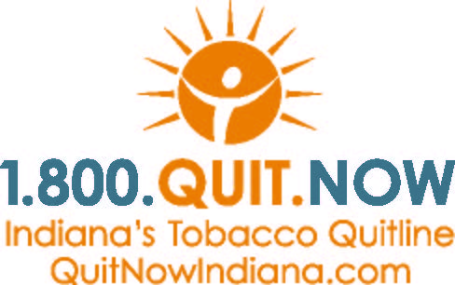
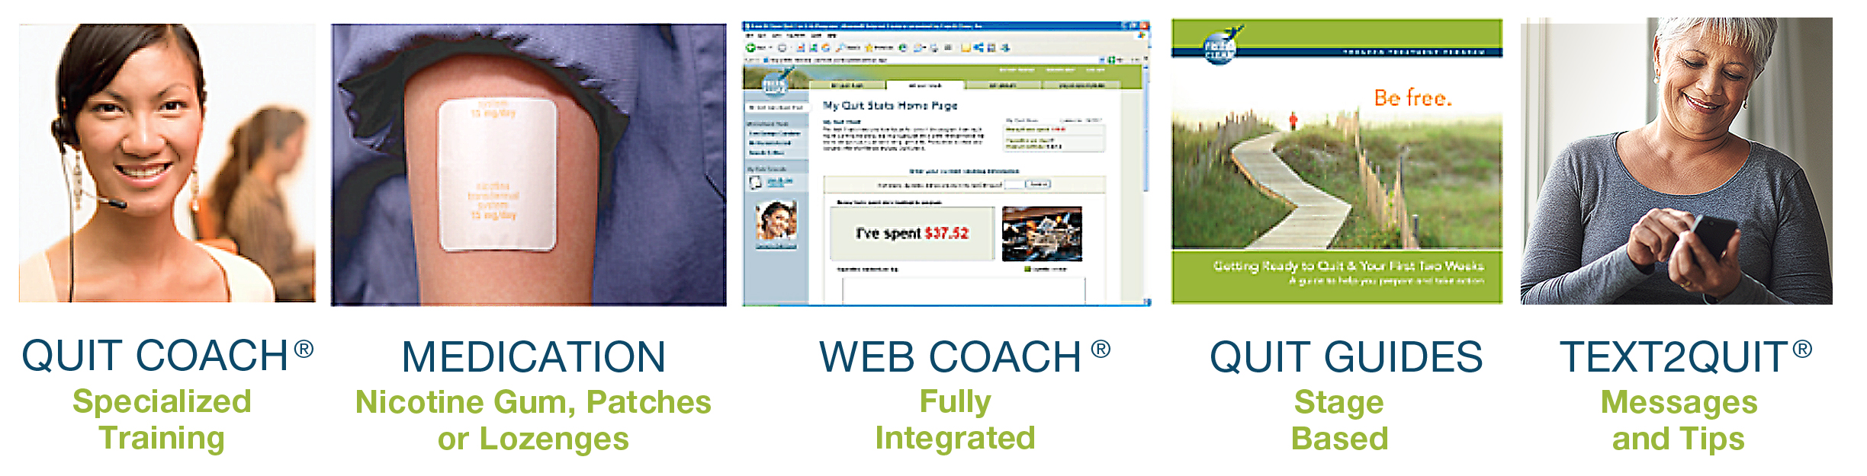
Indiana’s Tobacco Quitline
FREE and CONFIDENTIAL telephone-based counseling service to help Indiana tobacco users quit with a professional Quit Coach®.
Programs by Population | PLUS the Following:
4 Prearranged calls for Adults | Unlimited call-ins to the ITQL Text messages to connect with Quit Coach Free nicotine replacement therapy (NRT) products (patch, gum, or lozenge), if eligible. Access to online tools, videos, and educational materials on www.QuitNowIndiana.com
5 Prearranged calls for Youth
10 Prearranged calls for Pregnant Women
Notes:
About slide:
The Indiana Tobacco Quitline is a FREE and CONFIDENTIAL telephone-based counseling service to help Hoosiers quit using tobacco products (including e-cigarettes).
The Quitline is staffs dedicated Quit Coaches who are highly trained in cognitive behavioral therapy and who have helped hundreds of people quit using tobacco. The Quit Coach works with participants one-on-one and guide them through the process of breaking their tobacco addiction and work with the participants to develop an individualized quit plan.
The quitline is available for Spanish speaking consumers but can accommodate over 150 different languages.
Youth program is ages 13-17
Research has shown that proactive phone counseling is more effective than less intensive approaches like self-help materials. A review of multiple quitline studies indicated that proactive quitlines, like the Indiana Tobacco Quitline, showed a 56% increase in quit rates when compared to self-help (people quitting on their own) (Stead et al. 2004).

Slide 29
Behavioral Health Program
Behavioral Health Program includes:
Programs by Population | PLUS the Following:
7 Prearranged calls with Quit Coach for Behavioral Health consumers. Quit Coaches have received additional training on mental illness and tobacco cessation. | Free 12-week regimen of combination therapy NRT (patch + gum or lozenge) Letter sent to MH provider informing of quit attempt Unlimited call-ins to the ITQL Text messages to connect with Quit Coach Access to online tools, videos, and educational materials on www.QuitNowIndiana.com
Notes:
About Slide:
This program includes higher intensity behavioral and pharmacological support for callers with a behavioral health condition.
These enhanced services include 7 prearranged calls from their quit coach, and these Quit Coaches have received additional training on mental health conditions and tobacco cessation.
In addition to the increased number of calls, those who enroll in the behavioral health program with the quitline receive FREE 12 week regimen of combination therapy NRT – Combination NRT is recommended by the Clinical practice guidelines and has shown increased rates of long-term abstinence over monotherapy.
And lastly, enrolled callers will have a letter sent to their mental health provider informing the provider of the patient’s quit attempt. They also receive access to the other services and resources discussed.

Slide 30
Summary
Tobacco use disparities exist. Smoking rates are 3 to 5 times higher among persons with mental illness or SUD, compared to that of the general population.
Approximately half of all tobacco-related deaths each year are among persons with behavioral health conditions.
Tobacco use exacerbates symptoms of behavioral health conditions and negatively affects treatment and recovery. Tobacco treatment, during addictions treatment is associated with a 25% increase in long-term recovery.
Indiana has an overwhelming burden of premature death, disease, and disability from high tobacco use rates.
To maximize success, tobacco cessation interventions should include behavioral counseling and one or more tobacco treatment medications.
Behavioral health treatment facilities should adopt and implement TF-free grounds policies and integrate tobacco treatment into services.

Slide 31

Call to Action
Does your organization have a tobacco-free grounds policy?
How often do you screen patients for tobacco dependence?
Is there a dedicated field in your EHR for tobacco use assessment and treatment planning?
What types of tobacco cessation interventions do you offer to patients?
What FDA-approved medications do you offer or prescribe for tobacco treatment?
What percentage of identified tobacco users are provided with medications and/or counseling for tobacco treatment?
How often do you provide training to clinicians and staff on tobacco treatment?
Notes:
About slide:
Call to action to providers and organizations to examine how they currently assess and treat tobacco use.
These questions may be posed rhetorically or to engage the audience in a discussion.
The PHS Clinical Practice Guideline for Treating Tobacco Use and Dependence (2008) and the CDC recommend that clinics and health systems implement health systems changes to improve tobacco treatment delivery (eg, establishing a process to identify tobacco users, educating staff on tobacco treatment, providing resources and feedback to promote interventions. Evidence suggests that health systems change can improve care delivery processes compared with clinical settings where such changes were not implemented.
Multiple factors influence how and to what extent health systems can implement systemic changes to improve identification and treatment of tobacco use.
Engaging leadership at all levels of the organization facilitates tobacco project implementation and expansion, ensures that resources are available, and promotes sustainability of the delivery of tobacco treatment services.
The EHR can support routine clinical smoking cessation protocols and documentation and is a key component of health systems change for tobacco. Embedding clear workflows into the EHR and utilizing “smart forms” and reports to track and link tobacco use with other health conditions can facilitate improvements in patient care.
Implementing new protocols and building capacity through staff trainings are important facilitators of systems change and increases staff confidence in helping patients quit using tobacco.
Suggested literature review:
Whittet, M., et al. The Role of health systems in reducing tobacco dependence. The American Journal of Accountable Care. June 2019
CDC Promising Policies And Practices To Address Tobacco Use By Persons With Mental And Substance Use Disorders: https://www.cdc.gov/tobacco/disparities/promising-policies-and-practices/pdfs/osh-behavioral-health-promising-practices-20160709-p.pdf

Slide 32
SCLC Recorded Webinar Promotion
Credit for SCLC’s 2017 webinar collection of recorded webinars is now available for free. Please use the discount code SAMHSA23 to waive the $65 fee.
This Collection of recorded webinars includes all 10 webinars released during 2017, for a total of 13.50 CE credits. Topics include lung cancer screening, engaging health professionals, state and community approaches to tobacco control, quitlines, behavioral health, smoking mothers, cessation efforts in public housing community health centers, smokeless tobacco, behavioral health/public health partnerships, young adult smokers, and tobacco harm reduction.
Visit SCLC’s website www.smokingcessationleadership.ucsf.edu/webinar-promotion for more information.
Notes:
Support from national partner – SCLC. Free continuing education on several tobacco-related behavioral health topics.

Slide 33
QUESTIONS?
Insert presenter contact info
Notes:
Presenter Notes:
Encourage audience members to get involved with the Indiana Leadership Academy for Wellness & Tobacco Free Recovery (the Summit). Suggest to invite to committee meeting, if appropriate.
For more information on the summit visit: https://www.in.gov/isdh/tpc/2781.htm
For committee members – please note the questions you receive, and we can discuss together on our monthly committee calls.

